Slide 1
Formal Methods at Microsoft
Nikolaj Bjørner, Microsoft Research, RiSE
TLA+ Conference @ StrangeLoop
September 22 - 2022

Slide 2

Formal Methods tools from Design to Diagnoses
Design
Implement
Test
Deploy
Diagnose
TLA+
EverParse
Coyote
Bosque
LꓱꓯN
KOKA
Verus
HyperFuzzer
Torch
RESTler
F*
EverCrypt
Zen
NCVS

Slide 3
A tool-oriented view
Logic – Calculus of Computation
Symbolic Model Checking
Model-Based Testing
Program Verification
Tomography of Computation
Concurrency Testing
Fault Injection
Fuzzing
Logic and Tomography
Network Verification
I will talk about lots of tools:
Scientific heritage
Target Use
Impact
North Stars
Lots of material, yet very partial
I will not cover: TLA+, LꓱꓯN, Koka, MakeCode, Orchestration, Parallel Computation, Synthesis, RegEx
No theorems …. but I will point to a z3 guide

Slide 4
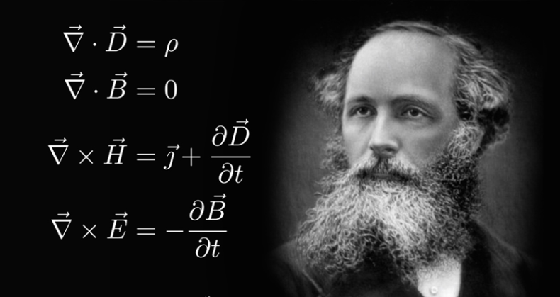
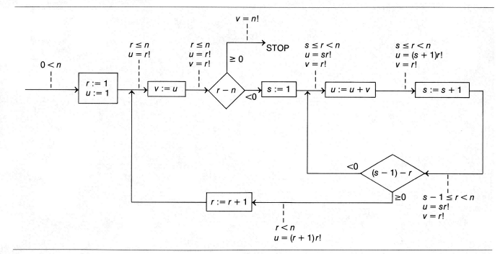
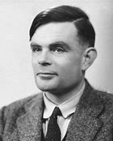
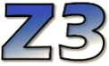
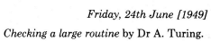
Logic: The Calculus of Computation
Invariants
Differential, Integral Calculus
Logic
Dynamics, Conduction,..
Matlab, Mathemetica, Simulink
Computation
Claim: Practically all modern program analysis tools involve solving logical formulas

Slide 5
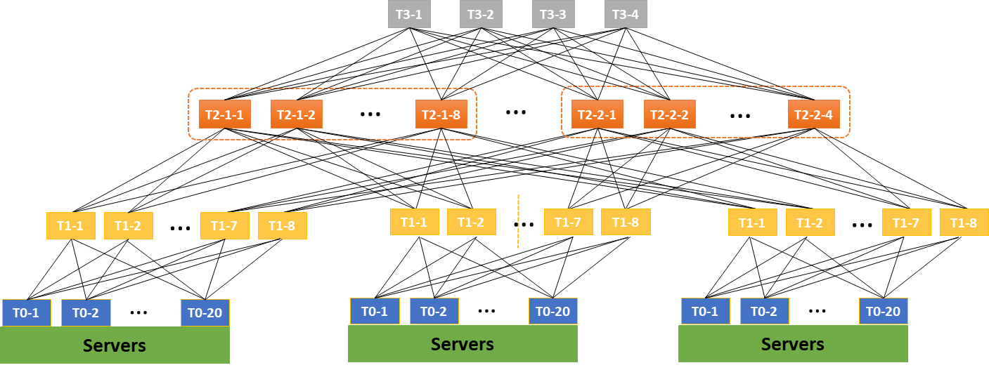

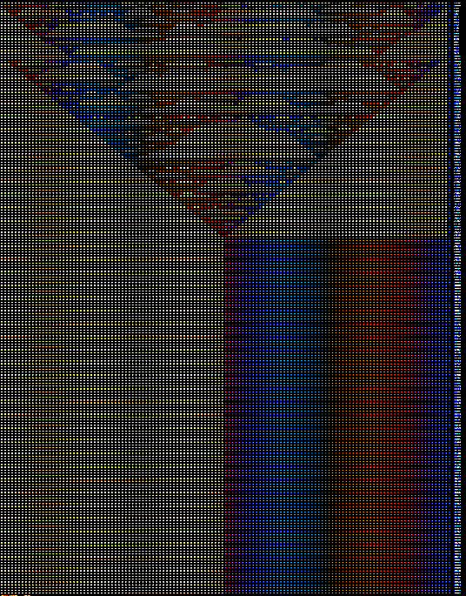
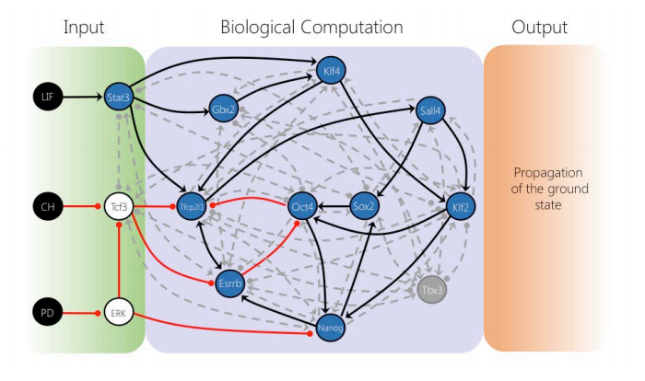



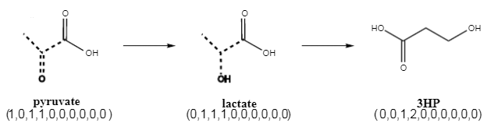

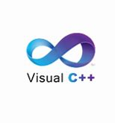
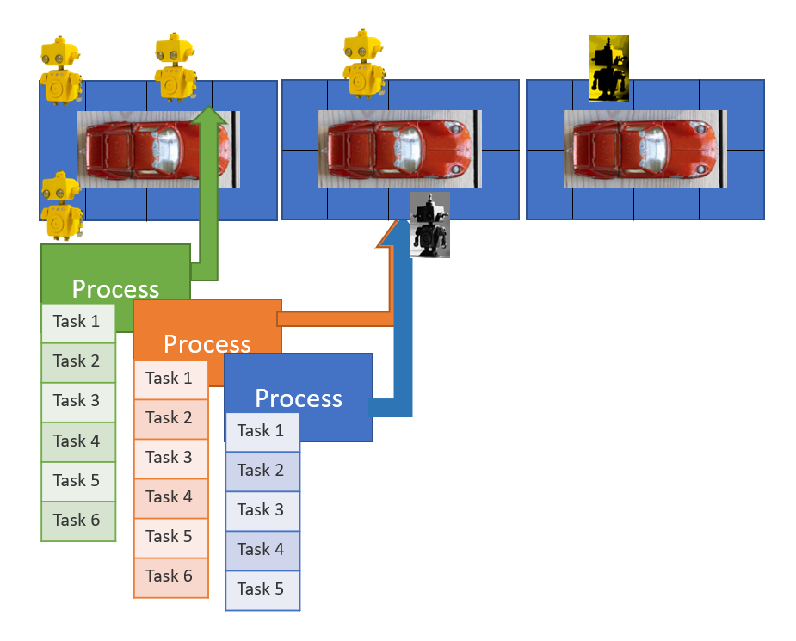
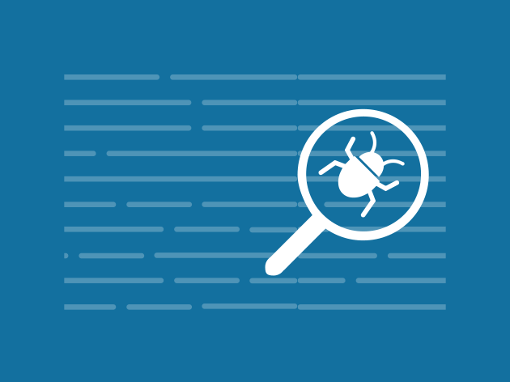


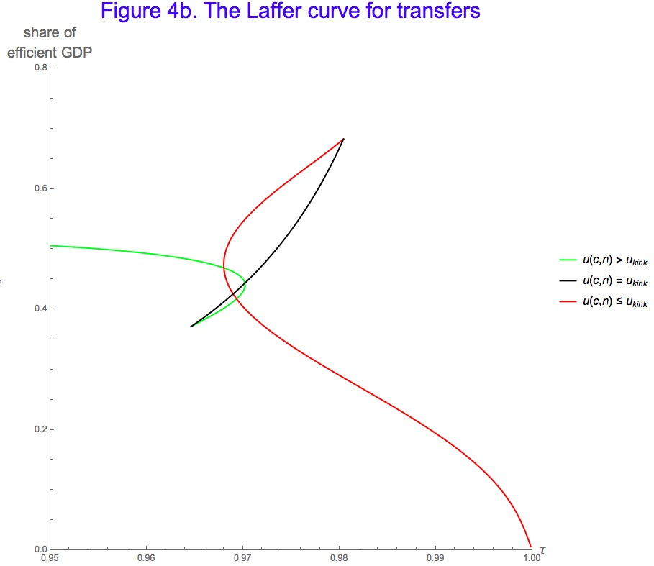
for Software +…
Azure Network
Verification
Verifying C
Compiler
Quantum
Compilation
Biological
Computations
Verified Crypto
Libraries & Protocols
Dynamics
AX
SVACE
Static Analysis Engines
Artificial
Life
Security Risk Detection
Smart Contract
Verification
ALIVE2
Translation Validation
for LLVM & Visual C++
Axiomatic
Economics
Assembly Line
Optimization

Slide 6
Efficiency
Scale
Technology Landscape
Propositional
Satisfiability Solving
SAT
Breakthroughs in 2000s
Cheap local Inferences
Garbage collect useless clauses
Hardware Design
Automation
Breakthroughs late 2000s
SAT + global inferences +
global propagators
Mixed Integer
Programming
MIP
Breakthroughs in 1960s
Harnessed since 1990s
LP: global Inferences
IP: Cuts, Branch and Bound
Satisfiability Modulo Theories
Operations
Research
CP-SAT
SMT
Z3
Constraint
Programming
Software Development +…
CP
Breakthroughs since 1990s
Powerful domain-tailored
global propagators
Expressive Power

Slide 7
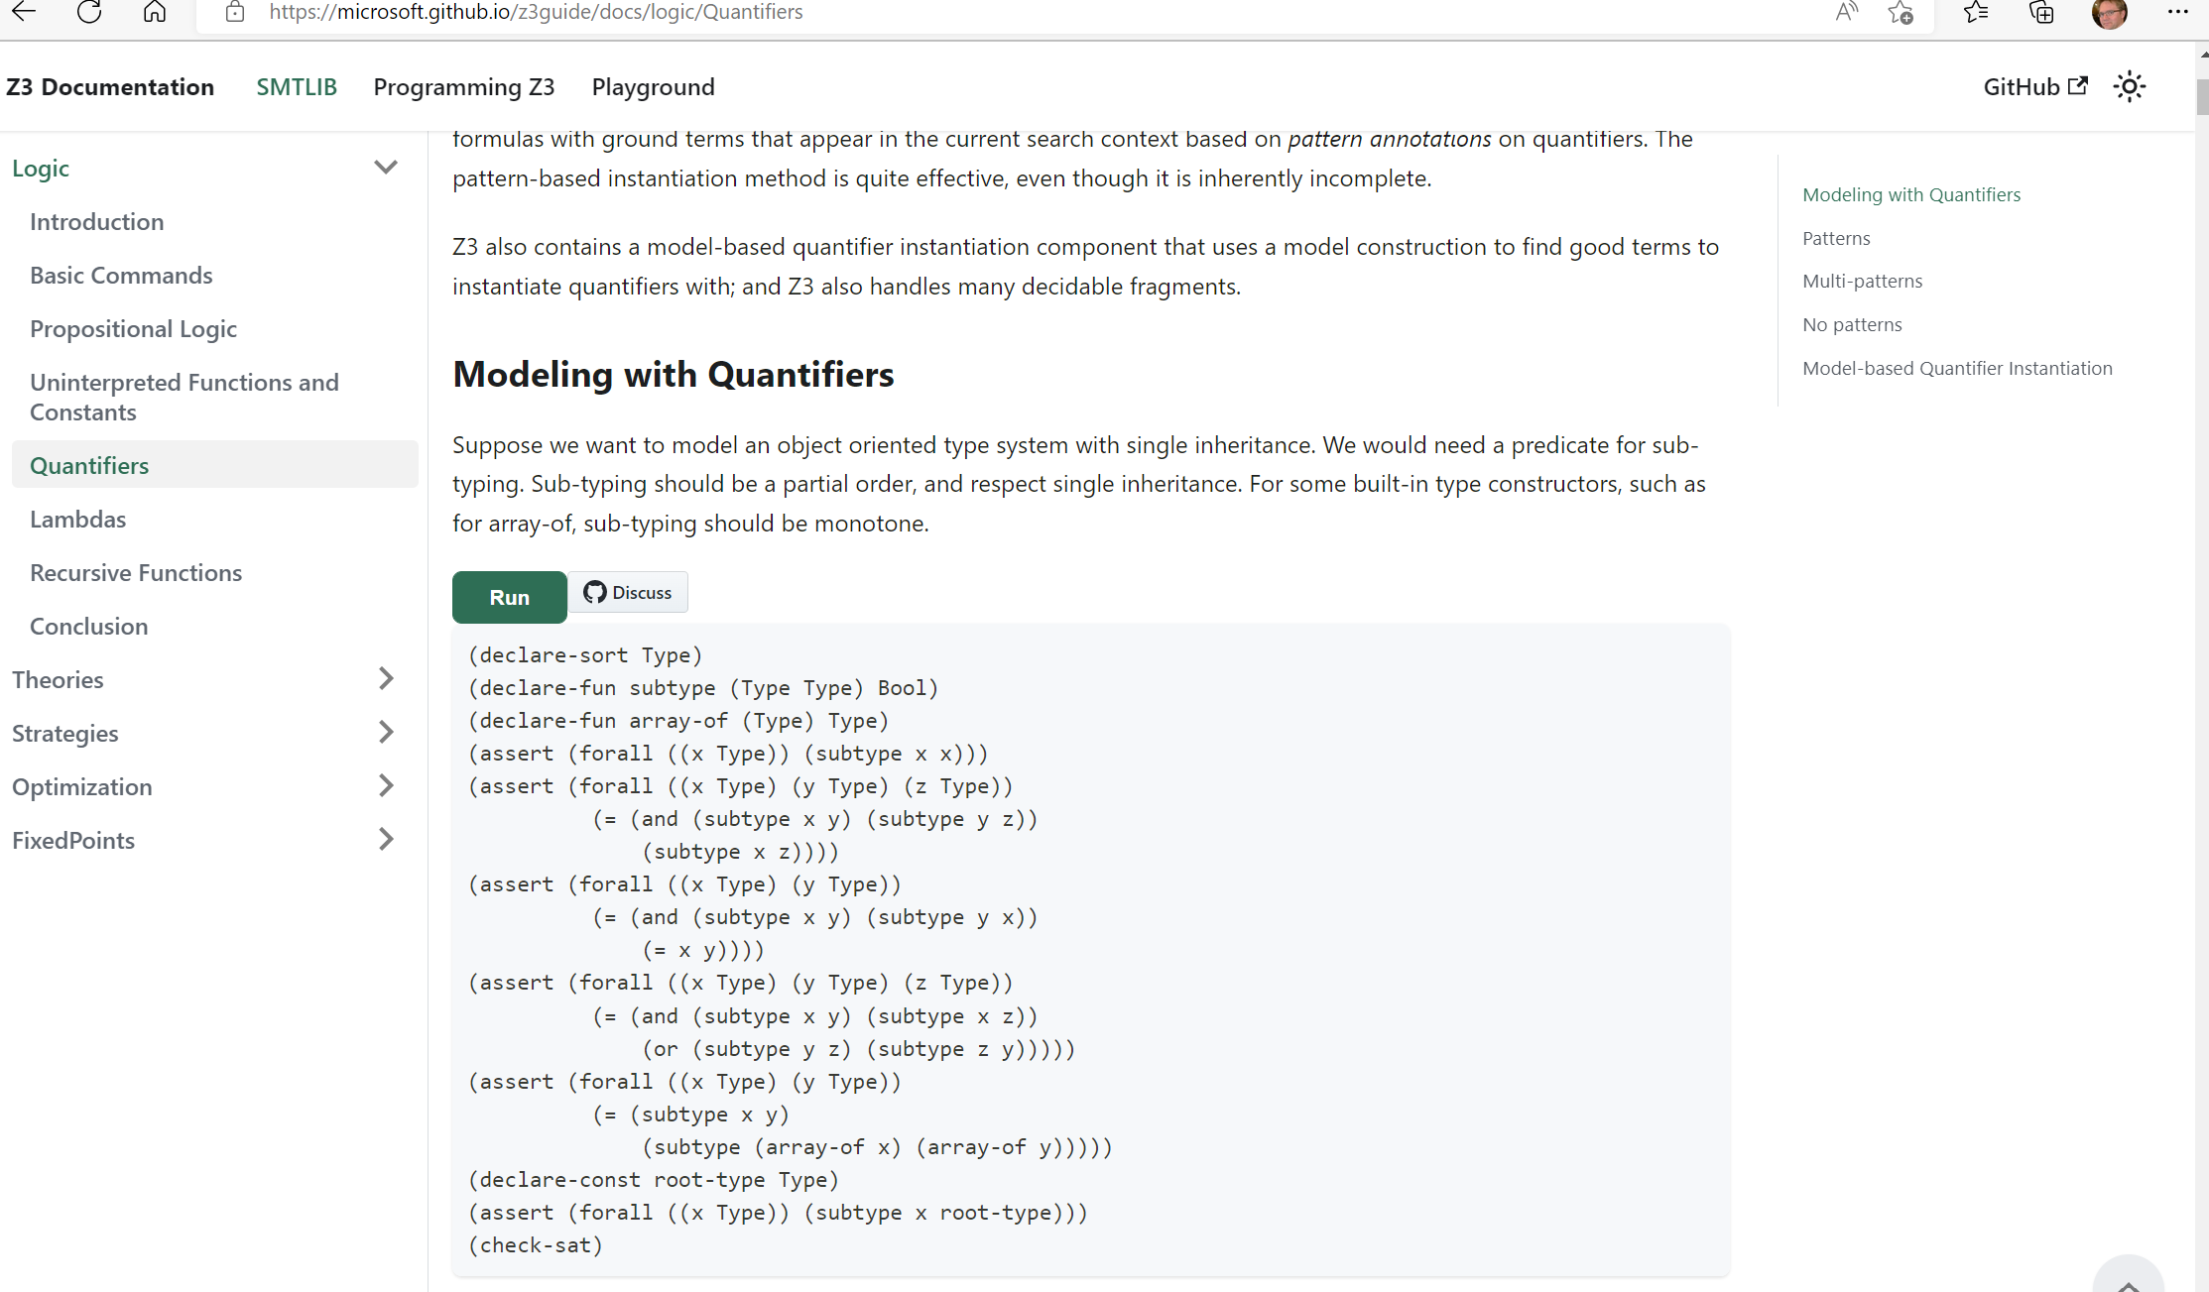

Slide 8



Symbolic Model Checking
Predicate Abstraction (1997)
IC3 (2010)
Interpolation (2000)
Static Driver Verifier
Proof Rules as Horn Clauses (2012)
SLAM (2001)
Solidity, MathWorks,..
Z3 PDR (2012)
Duality (2012)
Yogi (2009)
Crab AI in AFO eBPF filter
SPACER (2014)
SMACK (2014)
Corral (2014)
Global Guidance (2020)
Crab (2017)
Uninterpreted
Functions (2022)
Algebraic DT (2021)

Slide 9
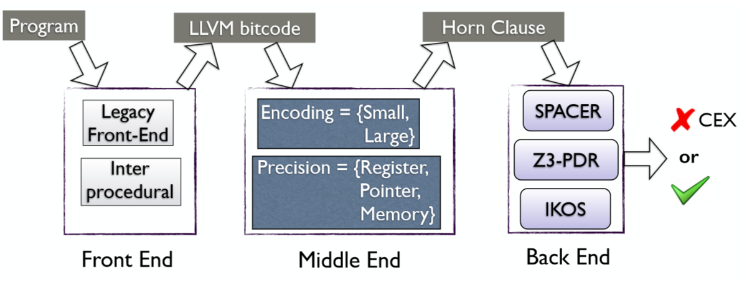

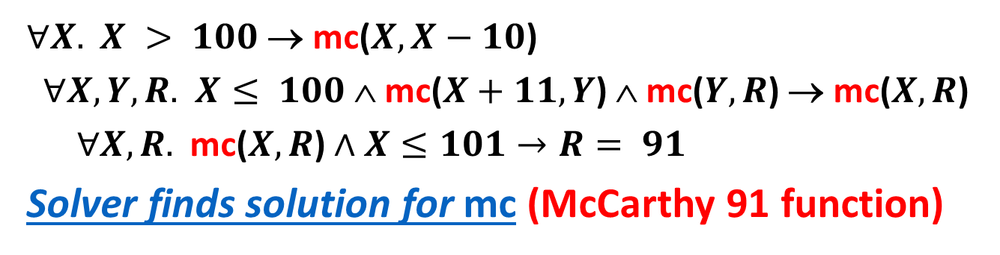
Constrained Horn Clauses
$∀X.$ $X > 100$→ mc($X,X−10$)
$∀X,Y,R.$ $X≤ 100$∧ mc($X+11,Y$) ∧ mc($Y,R$) → mc($X,R$)
$∀X,R.$ mc($X,R$) $∧X≤101→R= 91$
Solver finds solution for mc (McCarthy 91 function)
Arie Gurfinkel
U. Waterloo

Slide 10
Model Based Testing and Model Programs
ASML (1999)
Protocol Specs and Tests
SpecExplorer (2004)
NModel (2004)
PL for Network Verification
Formula (2008)
RFC Spec Exploration
Cloud API Contracts
Bosque (2019)
IVY (2019)
Zen (2019)

Slide 11

Zen - an intermediate policy representation
SMT solver
Zen<bool> Allow(Nsg nsg, Zen<Packet> pkt, int i) {
if (i >= nsg.Rules.Length)
return false;
var rule = nsg.Rules[i];
return If(Matches(rule, pkt),
rule.Permit,
Allow(nsg, pkt, i+1));
}
Zen Library
BDD engine
Interpreter
Test generator
Embedded Domain-Specific Language in C# [1]
Backends
https://github.com/microsoft/zen
[1] A General Framework for Compositional Network Modeling, R. Beckett, R. Mahajan, HotNets 2020

Slide 12
Bosque - for Financial Compliance (OSFIR)
typedecl ZipcodeUS = /[0-9]{5}(-[0-9]{4})?/;
function isNYCode(s: StringOf<ZipcodeUS>): Bool {
return s.value().startsWith(/1[0-4]/);
}
isNYCode('10001'#ZipcodeUS) //true
isNYCode('87111'#ZipcodeUS) //false
isNYCode("12") //type error not a StringOf<ZipcodeUS>
isNYCode('WC1E'#PostcodeUK) //type error not a StringOf<ZipcodeUS>
Functional IR (MorphIR)
Referential Transparency
Combinators: Map, Fold
Analysis Friendly
Bosque provides
Verification
Test-case generation
typedecl Percentage = Nat & {
invariant $value <= 100n;
}
let a = 100#Percentage;
let b = 101#Percentage; //Runtime Error
let q = a + 25#Percentage; //Runtime Error

Slide 13
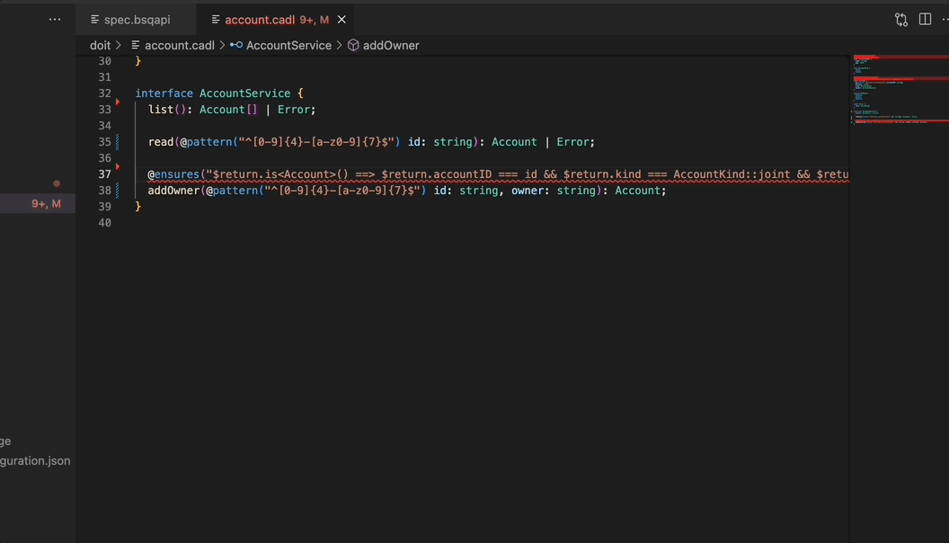
Bosque – The Future of the Cloud is APIs
Cloud Service Compositionality
Cloud Service Contracts
@requires
@ensures
@invariant
String Constraint Types
Bosque provides
Fuzz Tests
Auto-Mock

Slide 14

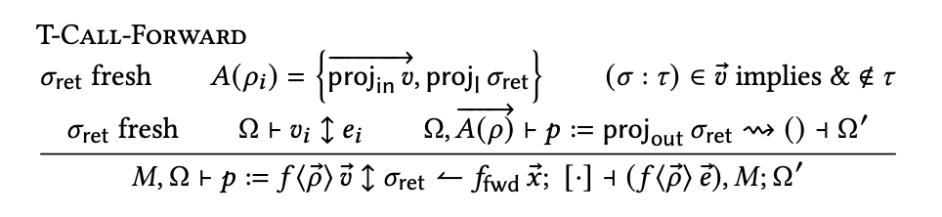
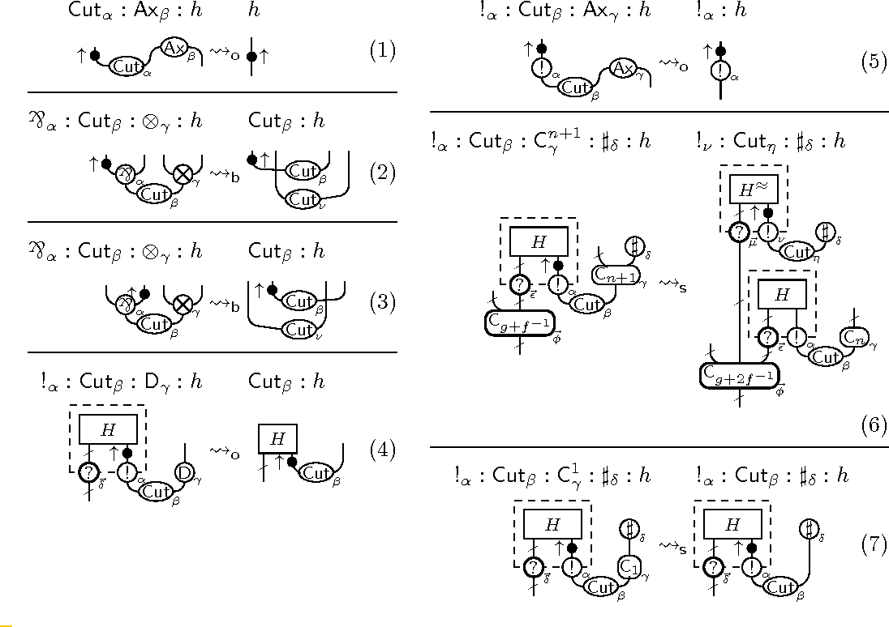
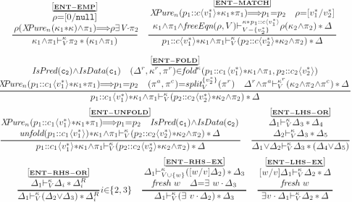
Systems Code Verification
FP & Logics
Boogie (2004)
F# (2001)
KISS (2004)
Spec# (2004)
Verve (2010)
F7 (2007)
HAVOC (2010)
VCC (2009)
Vale (2017)
F* (2012)
Dafny (2010)
Chalice (2010)
EverCrypt (2019)
EverParse (2019)
Verona (2022)
Ironfleet (2015)
CIVL (2015)
Viper (2016)
SLAyer (2008)
Steel (2020)
VeriSol (2018)
Armada (2020)
Verus (2022)
Separation Logic (1999)

Slide 15

Languages embedded in F*
Certificate parsers
Key Exchange
Quantum programs
Concurrency & weak memory models
Embedded
domain-
specific
languages
ASN1*
Noise*
Q*
Armada
EverParse
Verified C programs
Low*
Vale
Verified
assembly code
Verified parser
generator
Steel
Concurrency & distribution
Logical
foundations
of programs
and proofs
Interfacing
with existing
toolchains
Ocaml, F#, …
WebAssembly
C
X86 Assembly
… Rust?
Q#

Slide 16
F*: A Proof-oriented Programming Language
EverParse
Vale
asm
crypto
MPC
Steel
Quic record layer
DICE
Noise
Zeta
HACL-v2 xN
Access
control
TLS-1.3
record
layer
HACL*-v1
crypto
Type-based Protocol
analysis
EverCrypt
Signal
Multi-tier programs
Compiler certification
Secure compilation
TypeScript
JavaScript
Applications
2007 08 09 10 11 12 13 14 15 16 17 18 19 20 21 22
Fable F7 Fine FX F5 F* monadic-F* relational-F* multi-monadic-F* universal-F* meta-F* layered-F*
Foundations
Extensional type theory, with refinement subtyping, proof irrelevance, tactic & SMT-based proofs
Expressiveness to state and attempt a proof of nearly any statement in mathematics (like Coq, Lean etc.)
With a focus on programming, including features, like state, exceptions, non-determinism, concurrency, IO
Integrated with Z3, so that many proofs are automatic,
but when Z3 gives up, you can fall back on manual proofs

Slide 17
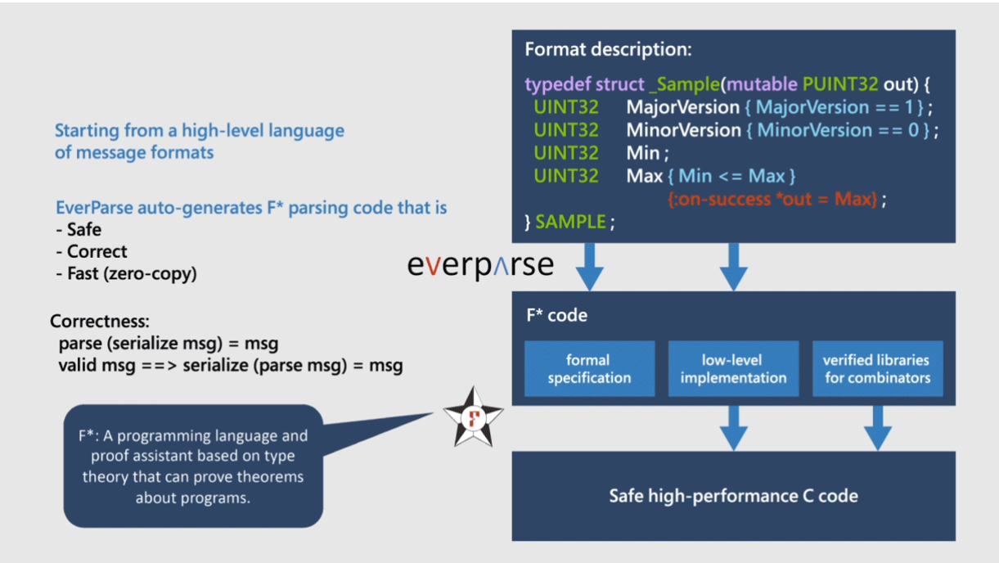

EverParse
Mathematically proven parser generator
High-performance code generation
Integration into critical systems code

Slide 18
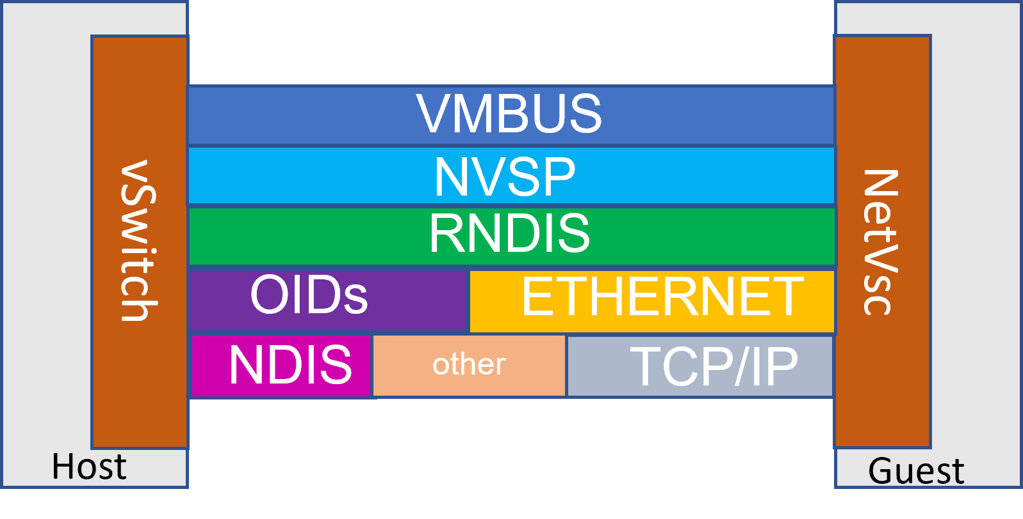
EverParse - Hyper-V vSwitch since 2019
Now in Windows 10, 11, and Azure Cloud: Every network packet passing through Hyper-V is validated by EverParse’s formally verified code
Hand-written alternative: historically 30% of all Hyper-V bugs are due to parsing
NVSP, RNDIS, OIDs and NDIS
Some of which are proprietary
Other formats (TCP, etc.) in progress
5K lines of 3D specification
137 structs, 22 casetypes, 30 enum types
Verified in 82 s
Generated 23K C code
High performance: <2% cycles/byte overhead
A sweet spot for formal proof
Guarantees of memory safety and functional correctness
Provably correct by construction: Zero user proof effort
High-performance code generated from data format description in a high-level declarative language
High return on investment wrt. attack surface

Slide 19
Vale - Fast verified crypto (via verified assembly)
Fastest
OpenSSL
assembly
code

Slide 20
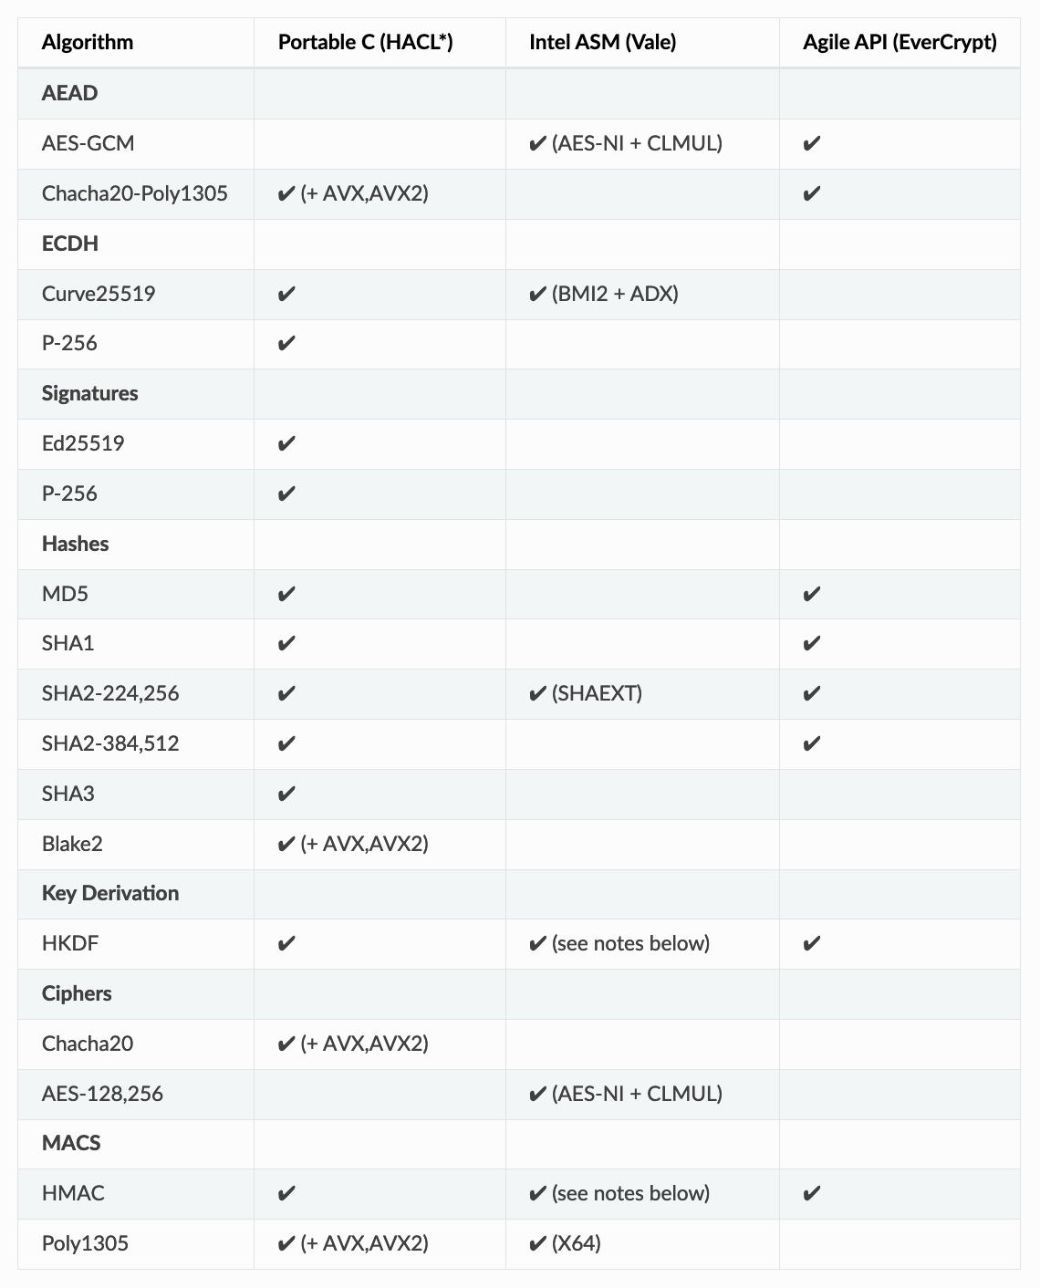
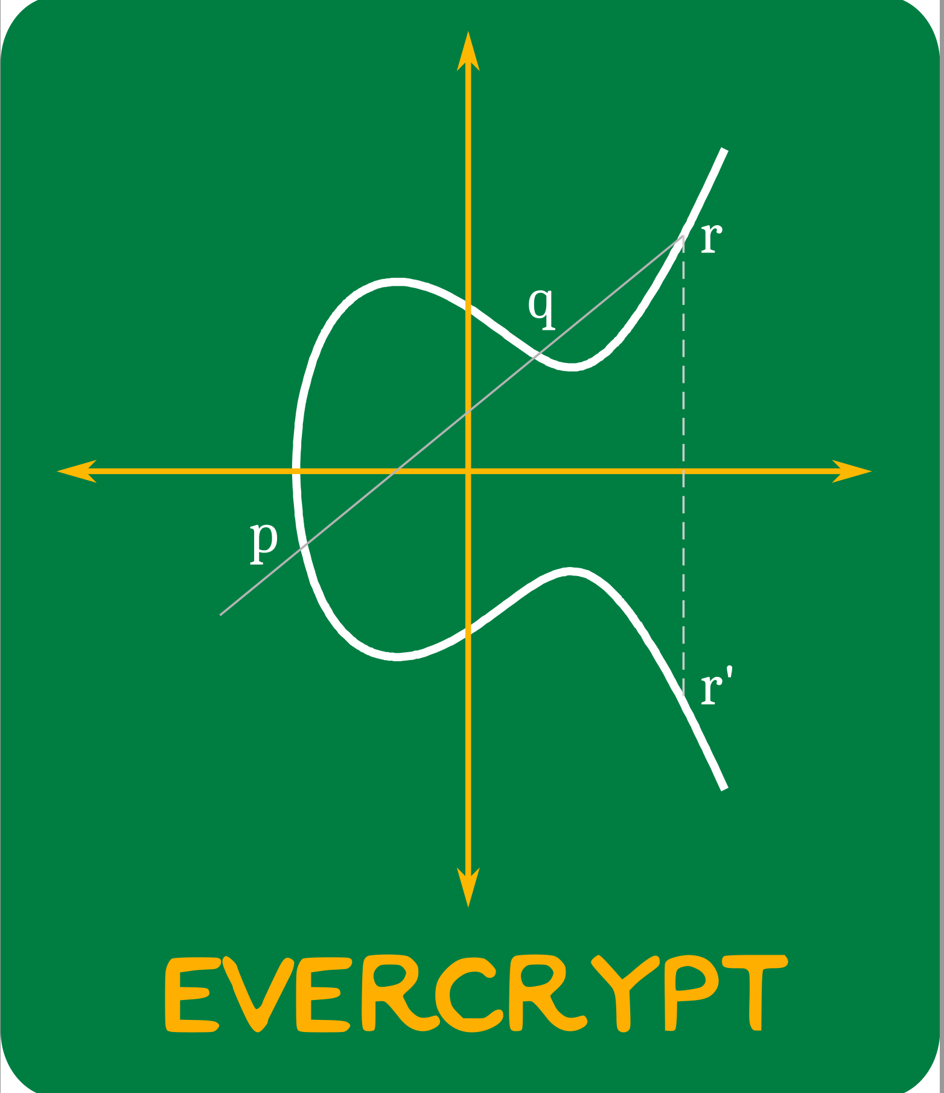
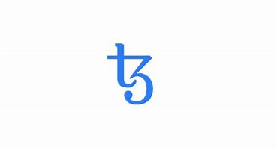









EverCrypt
A verified high-performance cryptographic provider
- A collection of algorithms (exhaustive)
- Easy-to-use API (CPU auto-detection)
- Several implementations (multiplexing)
- APIs grouped by family (agility)
Clients get state-of-the art performance.
130,000 lines of Low* and 24,000 lines of Vale (F* DSLs)
65,000 lines of C + 15,000 lines of ASM
Proof : Code ratio ~ 2 : 1
EverCrypt: A Fast, Verified, Cross-Platform Cryptographic Provider; IEEE S&P 2020
DICE
Azure CCF
Quic transport,
MSQuic in Windows,
Verified crypto in Firefox, mbedTLS,
Verified cryptography in the Linux kernel

Slide 21
Verified systems at SOSP, OSDI
Python
IsabelleHOL
seL4 (SOSP 2009)
assembly
Ironclad (OSDI 2014)
Jitk (OSDI 2014)
Dafny
IronFleet (SOSP 2015)
FSCQ (SOSP 2015)
C
Yggdrasil (OSDI 2016)
LLVM
CertiKOS (OSDI 2016)
Komodo (SOSP 2017)
C
DFSCQ (SOSP 2017)
Hyperkernel (SOSP 2017)
CSPEC (OSDI 2018)
Coq
Z3
Nickel (OSDI 2018)
DiskSec (OSDI 2018)
Serval (SOSP 2019)
Rosette
Perennial (SOSP 2019)
Vigor (SOSP 2019)
Go
VeriFast
AtomFS (SOSP 2019)
Jitterbug (OSDI 2020)
GoJournal (OSDI 2021)
Agda
SCFTL (OSDI 2020)
VeriBetrFS (OSDI 2020)
SeKVM/VRM (SOSP 2021)
Knox (OSDI 2022)
DaisyNFS (OSDI 2022)
VIA (OSDI 2022)

Slide 22
Languages for verifying systems code
More like Haskell/ML
More like C/C++
Verified
Rust?
F*
Dafny
VCC
Rust is like Haskell/ML:
Type-safe
Algebraic datatypes
Pattern matching
Side effects are restricted
Rust is like C/C++:
Low-level pointer manipulation
No garbage collector
Structs inside structs
In-place mutation of fields
Rust is unique:
Linear types
Borrowing

Slide 23
Languages for verifying systems code
More like Haskell/ML
More like C/C++
F*
Dafny
Verus
VCC
Cloud Scale
PL for memory safety
Steel
Armada
Verona
Structured Proofs
Separation Logic
Linear Types
Refinement
Weak memory model
Many concurrency primitives

Slide 24


Languages for verifying/safe systems code
More like Haskell/ML
More like C/C++
F*
Dafny
Verus
VCC
Full Stack Security
Rust Verification
Steel
Armada
Verona
Rust.Next
Scale to Next Order of Magnitude
Lock Free Data-structures for Critical Infrastructure

Slide 25
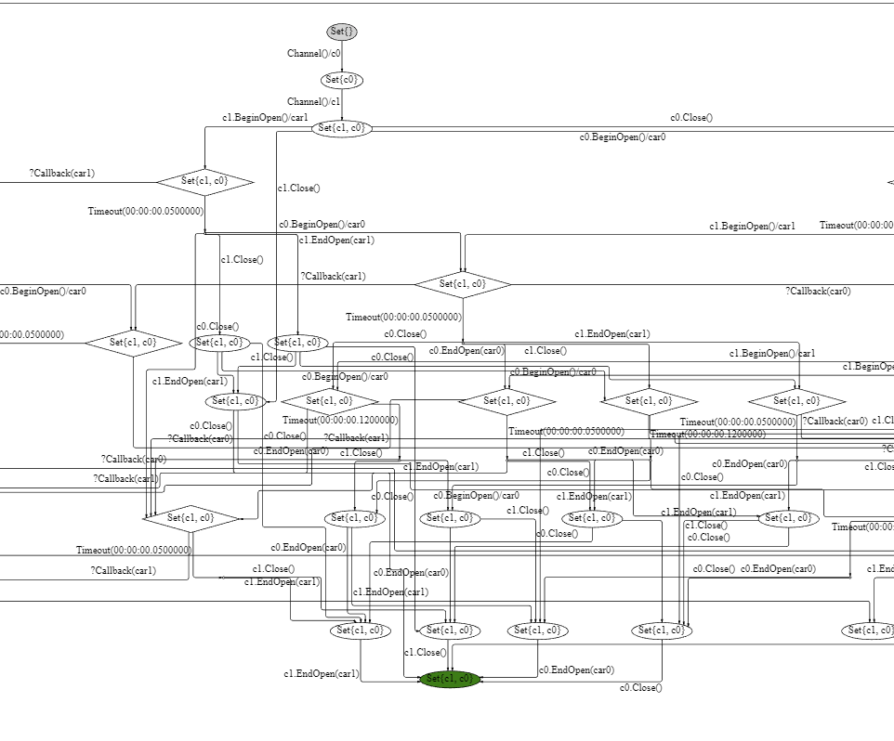
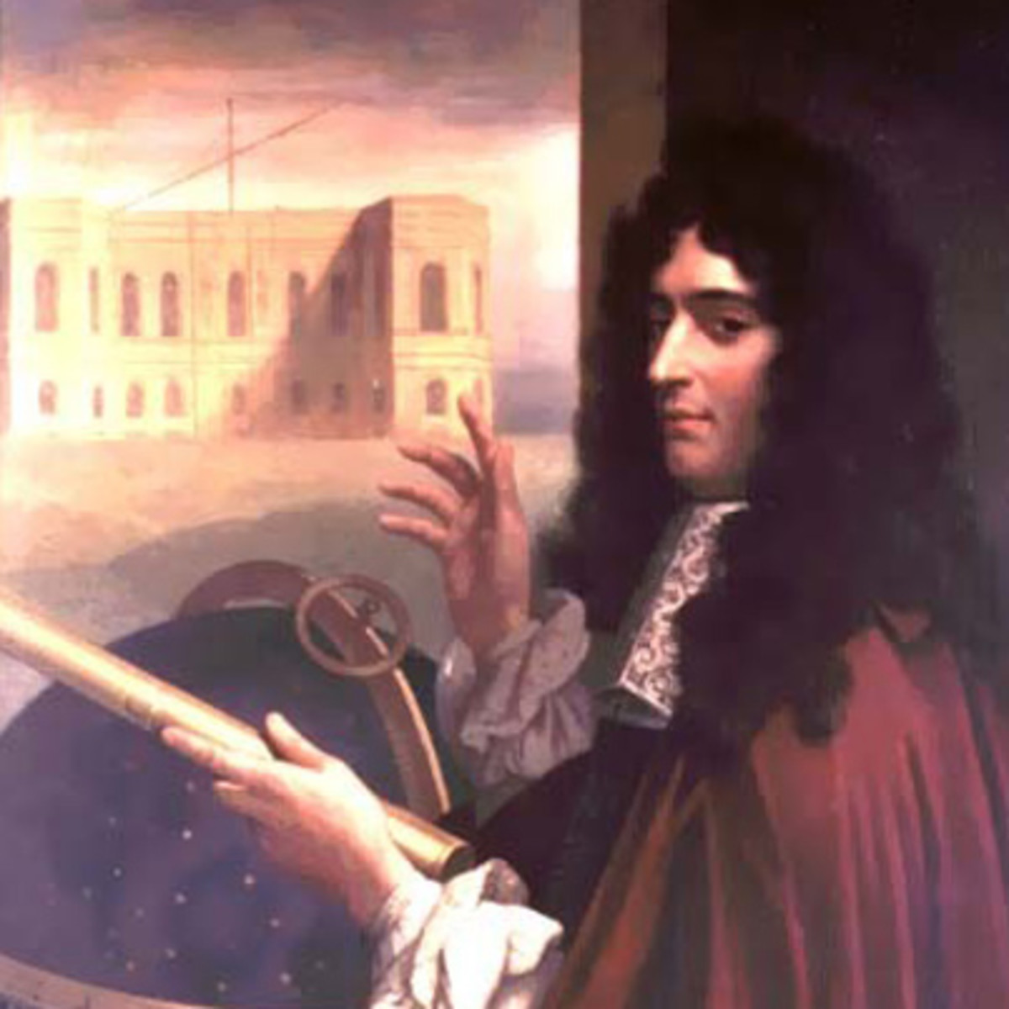
Tomography of Computation
SVG renderer with MSAGL-JS (microsoft.github.io)
Giovanni Domenico Cassini
Topographic map of France

Slide 26
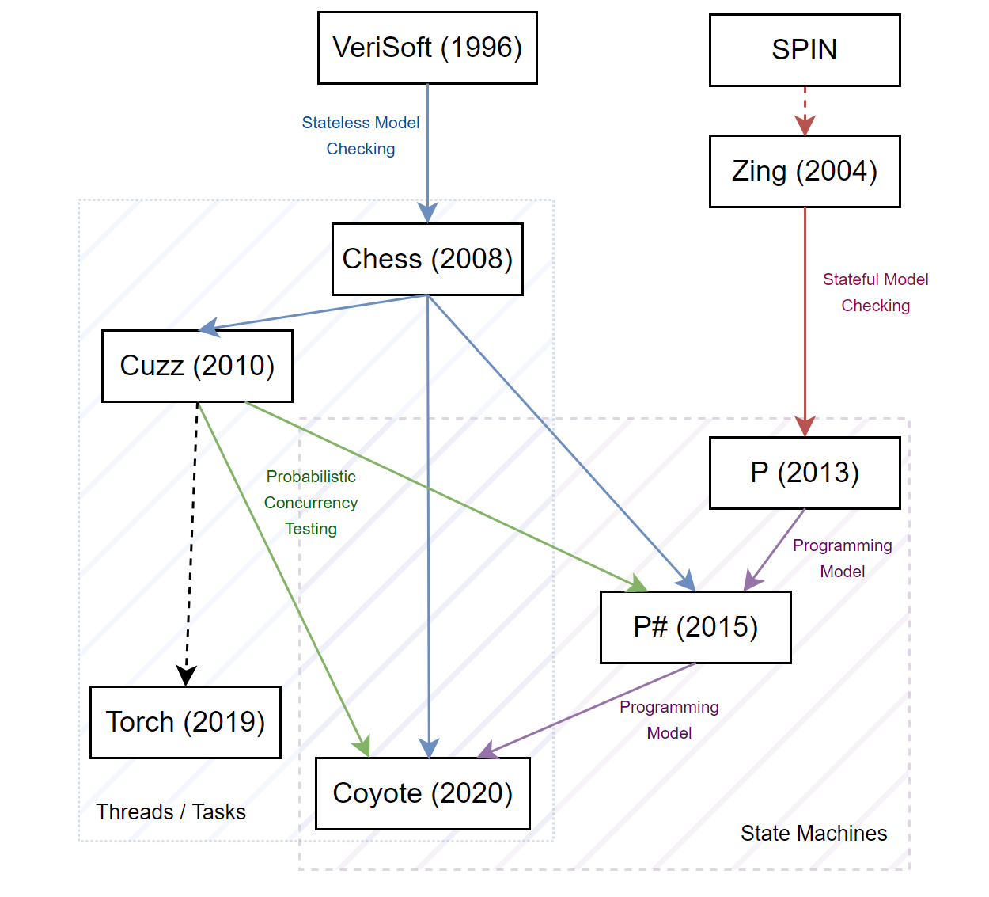
Concurrency Testing
KISS (2004)
Several Kernel OS bugs
Part of Windows AppVerifier
Integral to Microsoft dev
Dev/Test of several
main Azure services

Slide 27
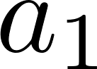
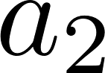
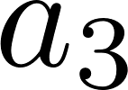
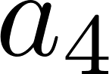
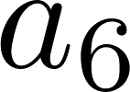
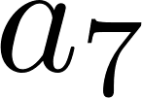
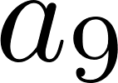
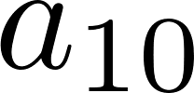
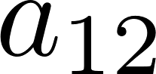
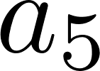
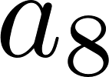
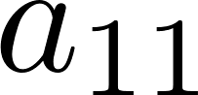
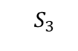
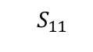
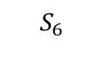
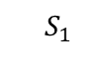
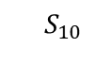
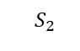
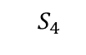
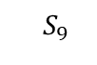
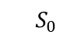
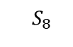



Controlled Concurrency Testing
Systematically explore space of program behaviors …by serializing concurrent program executions …using a scheduler which resolves control non-determinism …with deterministic replay
$${ S}_{0}$$
$${ S}_{1}$$
$${ S}_{2}$$
$${ S}_{3}$$
Bug
$${ S}_{4}$$
$${ S}_{5}$$
$${ S}_{6}$$
$${ S}_{7}$$
$${ S}_{8}$$
$${ S}_{9}$$
$${ S}_{10}$$
$${ S}_{11}$$
$${ S}_{12}$$

Slide 28

https://microsoft.github.io/coyote

Slide 29







Coyote @
Used in multiple Azure services
Usage ranges from unit testing to end-to-end scenarios
Covers failover, interleavings, timing, etc.
Test time in April 2022 (AppInsights)
Bugs found in April 2022 (AppInsights)
Downloads 988.1K

Slide 30







Coyote @
Coyote
.Net Intrinsics
Coyote
C++
Azure Networking
5 services
Azure Logistics
1 service
Azure Batch
3 services
Microsoft Teams
3 services
2017
2018
2019
2020
2021
2022
P#
State Machines
Azure Blockchain
2 services
Azure Storage
2 services (1 using the new C++ Systematic Testing)
Azure Compute
>10 services

Slide 31
Torch: Discover Synchronization “Torchpoints”
Randomized
Happens-before tracking
Happens-before inference
Trap at all TorchPoints, with a probability
+ Emulates a randomized priority scheduler
+ Finds each bug with a bounded probability
- Too many traps, may cause timeouts
Track happens-before relationship
Trap at independent TorchPoints
+ Fewer traps
- High tracking overhead
- Tricky to get right
Infer happens-before relationship at runtime
Trap at independent TorchPoints
+ Fewer traps
+ Low tracking overhead
API1(...);
API2(...);
API3(...);
API4(...);
API5(...);
[SOSP’19]

Slide 32

Torch: concurrency and fault-handling bugs
A push-button bug-finding tool for existing systems
Uses automated instrumentation + intelligent runtime algorithms
Reports bugs with existing tests, and without false positives
Concurrency bugs: due to thread-safety and order violation, interleaving, etc.
Fault-handling bugs: due to runtime faults
Integrated into Microsoft’s
Each day: ~300K tests are run with Torch, Torch reports bugs in ~1K tests
So far: reported ~3K unique bugs in ~30 Microsoft services

Slide 33

Fuzzing @
DART & CUTE (2005)
Grey Box – Model Based
Symbolic Execution
Billions of Queries
Million $ Bugs
SAGE (2006)
Pex (2006)
Randoop (2005) (2007)
Yogi (2007)
100s of Azure API bugs
Mocks (2011)
Vigilante (2008)
RESTler (2019)
11+ Hypervisor bugs
HyperFuzzer (2019)
OneFuzz (2020)
In Visual Studio Enterprise
IntelliTest (202..)

Slide 34
RESTler: REST API Fuzzing
RESTler = 1st Stateful REST API Fuzzer
Takes an API specification and automatically generates tests
Finds security and reliability bugs in REST services
Systematic state-space search and learning from responses
Input payload (schema and value) fuzzing
Targeted checks for security property violations
Open sourced on GitHub (since November 2020)

Slide 35

RESTler: beyond fuzz
Security validation
Regression & Parity validation
Reliability validation
RESTler core
Automatically generate tests
“are there resource
leaks when running
a workload with
resource creation
errors?”
“Does the service
have the same API
behavior across the
different regions
where it is deployed?”
“is authorization
working properly
across the entire
API”?
Many inputs
same API
Sequences of inputs
same API
Same input
API v1
API v2
Same input
API loc1
API loc2

Slide 36

HyperFuzzer – Fuzzing the Hypervisor
Unchartered territory
Traditional fuzzing rely on an OS layer for capturing instructions
The hypervisor does not have an OS…, doh
mixed executions between the guest and the hypervisor?
“hidden” hardware checks?
hypervisor internal states?

Slide 37





HyperFuzzer – Nimble white + Grey box fuzzing
Key insight: It’s the VM state that drives the hypervisor execution
VM State
Instruction Sequence
Symbolic Execution
+
=
1000+
tests/second
95% accuracy
11 bugs
Hypervisor bug
bounty @250K$

Slide 38

Availability, Reliability and the 5 9’s

Slide 39


What is a correct-by-construction network?
Reality $≡$ Intent

Slide 40


The Ideal of Verified Networks
The ideal of
verified software
Tony Hoare, 2007
Lasting power of abstraction:
Internet Protocol
isolated from
underlying transport
Vint Cerf
Main
questions
in the back
of our minds
How is intent specified?
Correct by construction: How is intent translated to configurations?
How is drift tracked and remediated?
How can we prevent changes from violating intent?
⇒ Azure Network Verification 2011-22

Slide 41
Network Verification - a timeline
Prototype
Research paper
Deployment
2012 2013 2014 2015 2016
SecGuru
DC ACLs &
Migration of Edge ACLs
NoD
Network
Optimized
Datalog
For generic
reachability in
virtual networks
Symmetries
and surgeries
All-pairs
reachability
in DCs
RCDC v1
Reachability Checker Azure Data Centers
NSG & UDR v1
Reachability for
customer Vnets
NLS v1
Jitu
Forms
Azure
NWV
Team
2018 2019 2020 2021
NSG v2
Catch live
misconfigs
RCDC v2
Fully deployed
NCVS Network Change Verification System
Spock, Zen, NLS, ONE
VNetVerifier v1
Reachability for
customer VNets
VNetVerifier v2
Azure Virtual
Network Manager

Slide 42





Live Monitoring of Forwarding Behavior
Global reachability as local contracts
Each router has a fixed rule for a set of addresses
Enough to verify rule is enforced on each router
R₁
R₂
R₃
R₄
Topology Database
D₁
D₂
D₃
D₄
Reachability
invariants
A₁
A₂
A₃
A₄
B₁
B₂
B₃
B₄
ToR₁
ToR₂
ToR₃
ToR₄
Error Reports
10.0.0.0/16
11.0.0.0/16
12.0.0.0/16
13.0.0.0/16
5 Billion Z3 queries per day
[Jayaraman et al, Sigcomm 2019]

Slide 43

Spock + Zen: programming local checks for each device
Initialization
Precompute expected next hops
For each device in the network
[SpockClassInitialize]
public void Initialize(Network n) {
this.ComputeExpectedNextHops(n.Topology)
}
[SpockTestMethod(scope: Device)]
public void LocalNextHopsTest(Device d) {
foreach (var (prefix, nexthops) in this.expectedNextHops[d]) {
if (prefix == "0.0.0.0/0") {
var rule = d.Fib.GetEntry(prefix);
Assert.AreNotEqual(rule, null);
Assert.AreEqual(nexthops, rule.Interfaces);
} else {
Assert.AllPackets(
If(ContainedBy(prefix),
NextHops(d, hops => nexthops.SetEquals(hops))));
}
}
}
Local scope
Check each device
separately, in parallel
Correct local forwarding
Verification
Check that all possible packets
are forwarded correctly.

Slide 44
Network Verification – Scope and Targets
SecGuru
Network Wide
Router Local
NoD
Symmetries
and surgeries
Internal
(Azure Ops)
External
(Customers)
RCDC
NSG
Design Time
(Control Plane)
NCVS
Runtime
(Data Plane)
AVNM
VNetVerifier

Slide 45



Enablers –Automated Reasoning Engines
Efficient Symbolic Solver
C# reflection:
Code and Configurations $$ Constraints
BDDs, Z3
Zen
Text and Programmatic API
Formalism support datatypes used in software
Leonardo de Moura
Virtual Machines
Emulation
Fidelity at Level of Router Software
Efficient search algorithms
+
Solvers tuned for datatypes used in software
ONE
Network Logic Solver
Simulation
Fidelity at Level of Standards and Firmware
(optimal)
Solution
Infeasible
Core
NLS
Consequences

Slide 46









NCVS: Network Change Verification System
RNG
RNG
Spock
DC
DC
DC
DC
DC
DC
NLS: Simulation
Topology
Manual
Operating
Procedure
(MOP)
SoNiC
Output: Routing tables (RIBs)
L2
T3
T4
Configurations
ONE: Emulation
100s of migrations verified
Dozens of Sev 1 & 2 outages prevented

Slide 47






ZenGuru - Virtual Network Verifier internals
Virtual deployment
pulled via public REST APIs
Abstract network graph
represents topology connectivity
Virtual policy IR
captures policy semantics
Backend solver
SMT, BDDs, etc.
If
guard
then
else
&&
false
...
==
...
x
Field
10.0.*.*
y
DstIp
z
Backends

Slide 48
Zen: an intermediate policy representation
SMT solver
Zen<bool> Allow(Nsg nsg, Zen<Packet> pkt, int i) {
if (i >= nsg.Rules.Length)
return false;
var rule = nsg.Rules[i];
return If(Matches(rule, pkt),
rule.Permit,
Allow(nsg, pkt, i+1));
}
Zen Library
BDD engine
Interpreter
Test generator
Embedded Domain-Specific Language in C# [1]
Backends
https://github.com/microsoft/zen
[1] A General Framework for Compositional Network Modeling, R. Beckett, R. Mahajan, HotNets 2020

Slide 49




Zen: an intermediate modeling language
NSGs
Virtual WAN
Service Firewalls
Service Endpoints
Firewalls
Route Tables
Virtual Peering
ASGs
Private Endpoints
VNets
Complex translations
Must implement one per policy type
$$fwd_{D_{1},I_{2}}={(b}_{1}∧b_{4})∨¬b_{7}$$
Error!
$$b_{1} \left| b_{2} \right| b_{3} \left| b_{4} \right|{ b}_{5} \left| b_{6} \right| b_{7} |…$$
$$fwd_{D_{1},I_{2}}={¬fwd_{D_{1},I_{2}}∧b}_{16}$$
Success!
Symbolic packet
System of equations
Constraint Solver

Slide 50
Zen: an intermediate modeling language
NSGs
Virtual WAN
Service Firewalls
Service Endpoints
Firewalls
Route Tables
Virtual Peering
ASGs
Private Endpoints
VNets
Simple translations
one translation to a high-level policy IR
Zen
$$fwd_{D_{1},I_{2}}={(b}_{1}∧b_{4})∨¬b_{7}$$
Error!
$$b_{1} \left| b_{2} \right| b_{3} \left| b_{4} \right|{ b}_{5} \left| b_{6} \right| b_{7} |…$$
$$fwd_{D_{1},I_{2}}={¬fwd_{D_{1},I_{2}}∧b}_{16}$$
Success!
Symbolic packet
System of equations
Constraint Solver

Slide 51
Confluences
SDN
Programming Languages
Symmetries in Datacenter Networks
IP header space vs. Forwarding Equivalence Classes
Modularity of Forwarding Tables
BGP Synchronization
Capturing Semantics of Policies
Bi-simulation and Congruences
Hash-tries, Header Space Algebras and BDDs
Floyd-Hoare and Rely/Guarantee Proof Rules
Abstract Dijkstra and A*
Reflection, Meta-programming

Slide 52






Summary: Logic, Tomography and Networks

